Slide 1
TMDB MOVIE DATA ANALYSIS
PROJECT

Slide 2
PROJECT OBJECTIVE
The objective of the project is to use Python programming to analyse a movie data to perform exploratory data analysis by answering the questions in the upcoming slides.
TMDB MOVIE DATA ANALYSIS
Movies that cost over $100 million can still fail, why so? Movie lovers might have different interests. A production company wants to analyse a movie dataset to identify what kinds of movies perform well in cinemas, which genres they belong to, and so on. It will help the company predict if a movie will be a commercial success, if the movie will be highly rated etc.

Slide 3
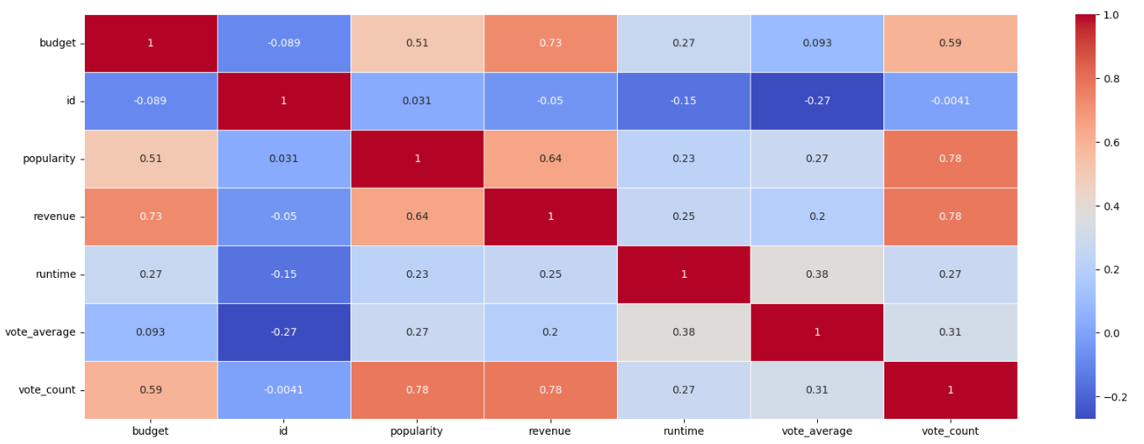
HEAT MAP OF DATA

Slide 4
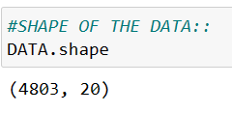
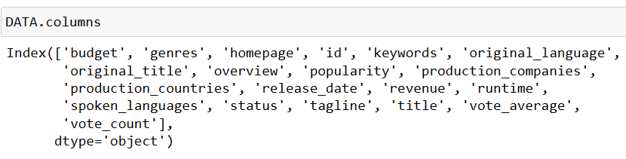
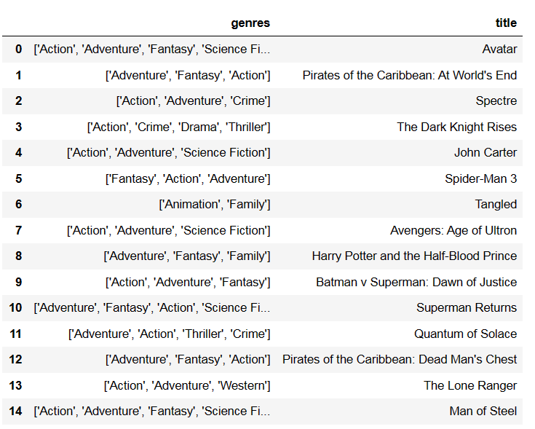
TASK-1
Load the movie dataset in the Python notebook. Display the numbers of rows and columns in -the dataset. Display the titles and genres of the first 50 movies from the dataset.
INTERPRETATION
After importing Libraries, we can load the data that is present in the CSV file.
There are Total 4803 Rows and 20 Columns in the Data.
Mostly First 50 Movies are Belongs to Action , Adventure , Fantasy, Science-Fiction, Crime, Animation, Thriller.

Slide 5
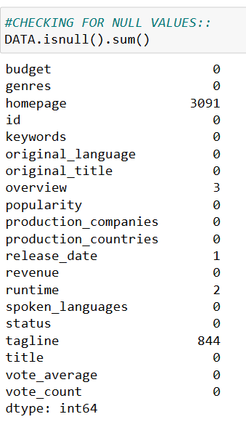
TASK-2
Identify the columns that have null values and perform the null value treatment. (Choose the imputation method based on the type of data in the columns of interest)
INTERPRETATION
Homepage and Tagline Columns have Null Values.
But We can not performed Imputations Method because these 2 columns are not Relevant for Further Analysis.

Slide 6
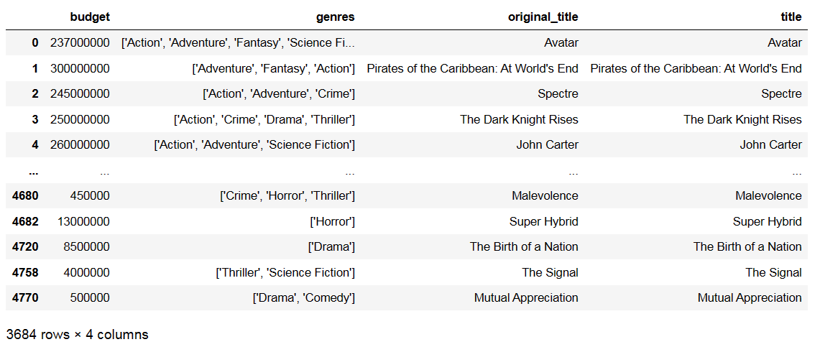
TASK-3
Display the movie categories that have a budget greater than $220,000.
INTERPRETATION
There are 3684 Movies Where Budget is Greater than $ 220,000.
Mostly Movies are Belongs to ACTION,ADENTURE,FANSTASY,SCIENCE-FICTION,DRAMA,THRILLER,COMEDY, HORROR.

Slide 7
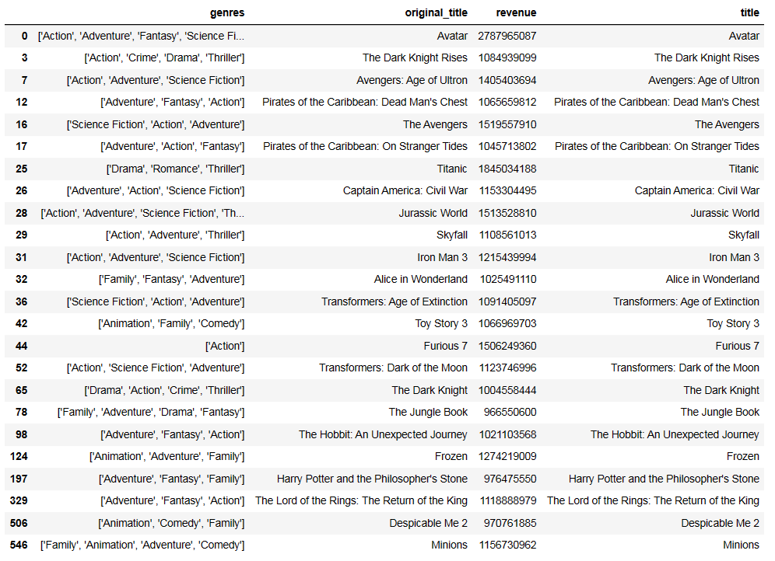
TASK-4
Display the movie categories where the revenue is greater than $961,000,000.
INTERPRETATION
There are 24 Movies Where Revenue is Greater than $ 961000000.
Mostly Movies are Belongs to ACTION,ADENTURE,FANSTASY,SCIENCE-FICTION,DRAMA,THRILLER,COMEDY, HORROR.

Slide 8
TASK-5
INTERPRETATION
In the dataset, there are some movies for which the budget and revenue columns have the value 0, which mean unknown values. Remove the rows with value 0 from both the budget and revenue columns
Remove all the Rows where Budget and Revenue value contain 0.
After Removing, Now Approx. 3684 Movies where Budget and Revenue Not Contain 0.

Slide 9
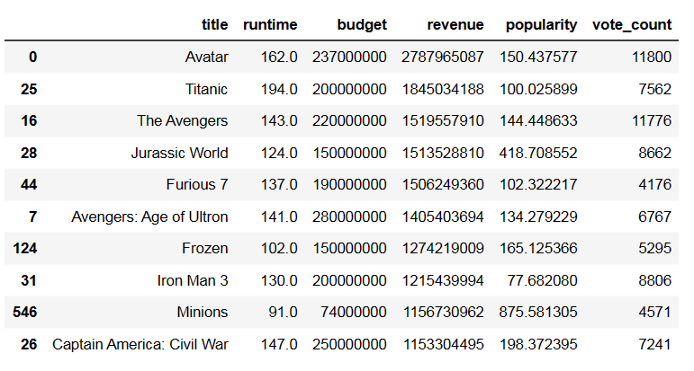
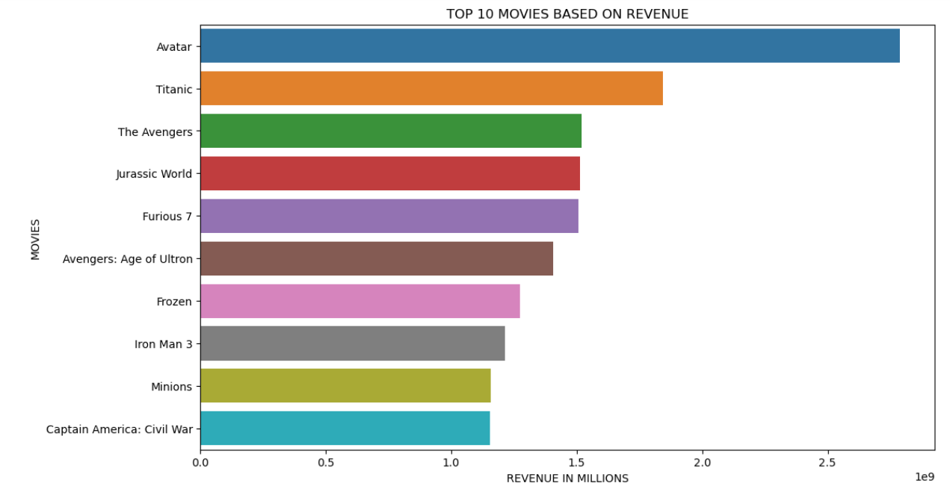
TASK-7
List the top 10 movies with the highest revenues and the top 10 movies with the least budget.
INTERPRETATION
There are 10 Movies Where Revenue is Highest.
Like “Avtar", "Titanic", "The Avengers” have Highest Revenue Range that is 1.5 to 3.5

Slide 10
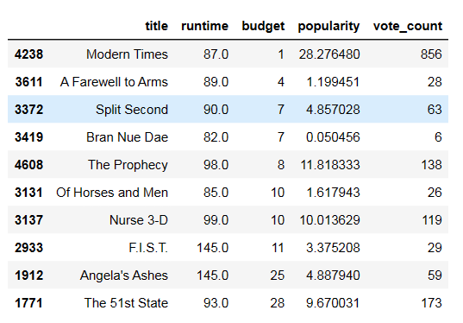
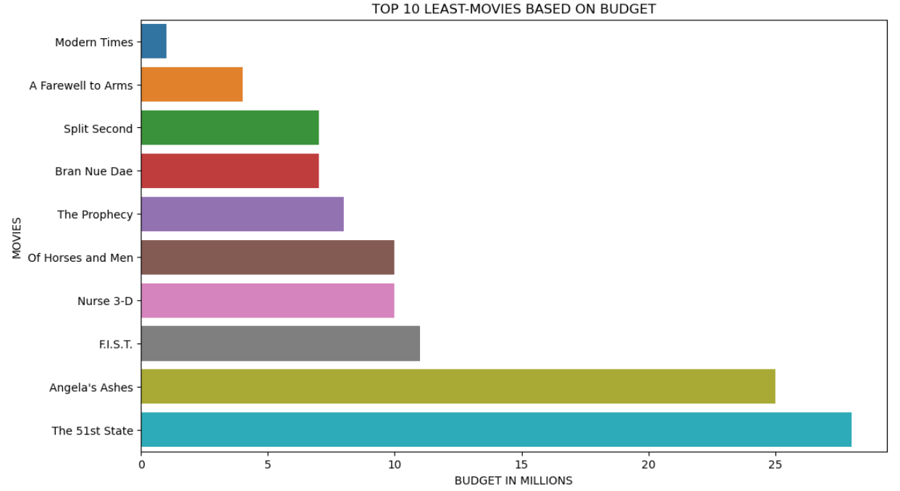
INTERPRETATION
There are 10 Movies Where Budget is Very Less.
Like “Modern Times", “A farewell to Arms", “Spilt Second” have Least Budget Range that is 0.1 to 5

Slide 11
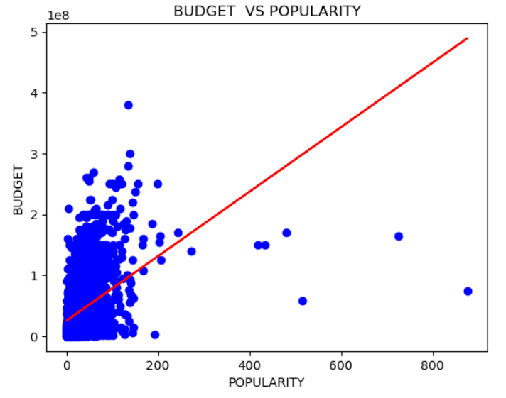
TASK-7
How are popularities of movies related with the movie budgets? Are they correlated or totally uncorrelated with each other? Write the interpretation of your analysis.
INTERPRETATION
Budget and Popularities are Correlated , the Value of Correlation is Approx. 0.6, so we conclude that budget and popularities are not strong corelated. Its Correlated when Budget is Increase Popularity is also increase.

Slide 12
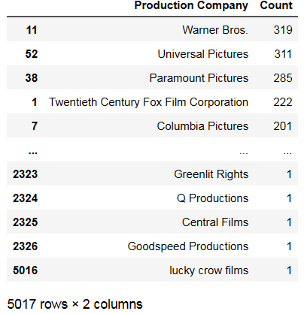
TASK-8
Identify and display the names of all production companies along with the number of times they appear in the dataset.
INTERPRETATION
There are Approx. 5017 Production Companies, in which “warner Bros”, “universal Pictures", "Paramount Picture” and Mostly these Production Companies are involved in almost Movies.

Slide 13
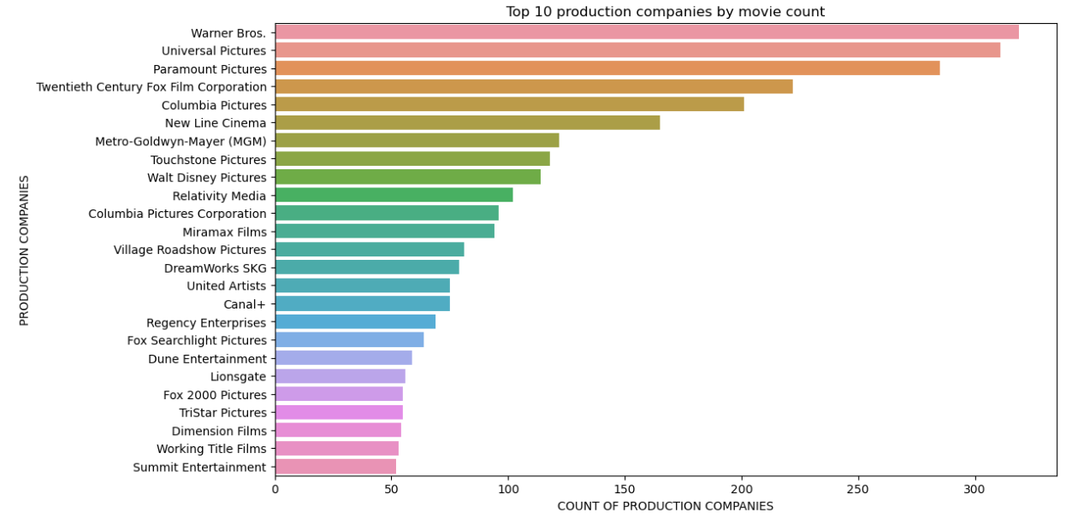
TASK-9
Task-9: Display the names of the top 25 production companies based on the number of movies they have produced in descending order of the number of movies produced.
INTERPRETATION
There are Top 25 Production Companies, like “warner Bros”, “universal Pictures", "Paramount Picture”.
In “warner Bros”, “universal Pictures", "Paramount Picture” have tough Competitor in Production Segment.

Slide 14
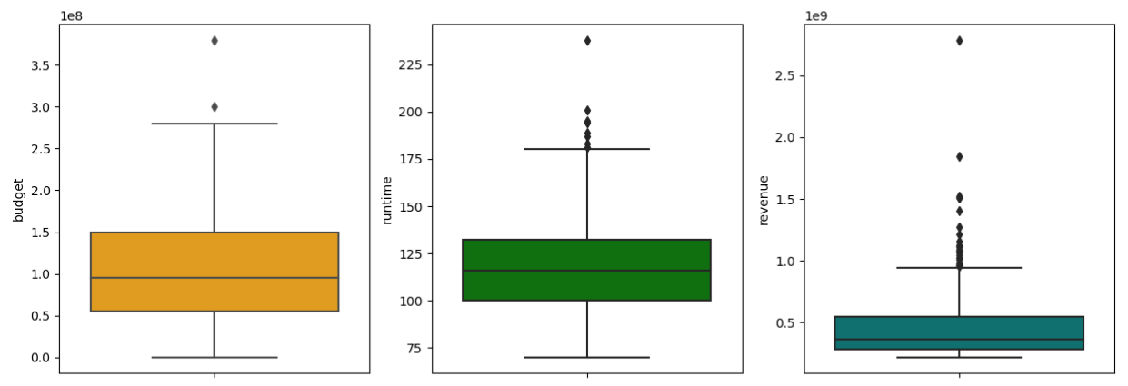
TASK-10
Sort the data in descending order based on revenue and filter the top 500 movies. Find the measures of central tendency for the following columns using the filtered data:
1. budget
2. revenue
3. runtime
INTERPRETATION
On the basis of measures of central tendency i.e.. Mean, median , and mode for budget , runtime, revenue.
Mean is greater than the median for all the three parameters which shows the data is positively skewed.
On the boxplot for budget and runtime there are very less number of outliers.
For revenue the data is more concentrated till $500 billion and some outliers are also present in the data .
Due to the presence of outliers the mean is drawn towards the higher values and cause skewness in the data.

Slide 15
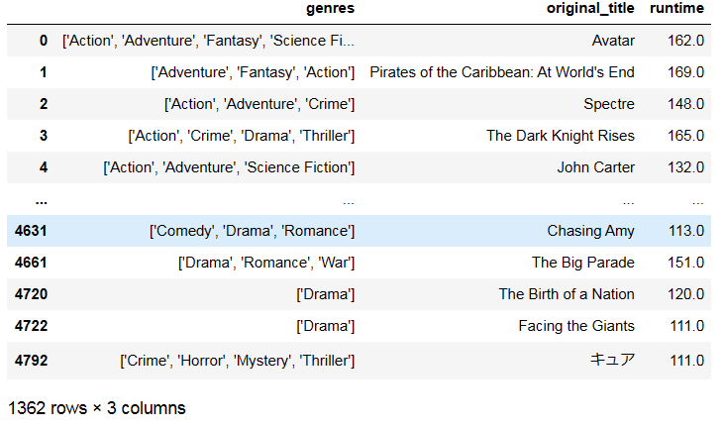
TASK-11
Identify and display the names of the movies along with their run times for those movies that have above average runtime, using the data from the previous task.
INTERPRETATION
There are 1362 Movies where the Average Runtime is Greater.
The Average Runtime is Approx. 108

Slide 16
CONCLUSION
On the basis of revenue only we can determine whether a movie is a commercial success or not, but yes budget, popularity, vote count all contribute towards a commercial success.
In terms of correlation between budget and revenue i.e. 0.71 , for a movie to be a commercial success , contribution of budget is only 7/10 i.e. 7 out of 10 movies with high budget can be a commercial success.
In terms of popularity , 6 out of 10 movies that have high popularity can become a commercial success, since the correlation between popularity and revenue is 0.61
In terms of vote count , 8 out of 10 movies that have a high vote count can be a commercial success.

Slide 17
THANK YOU
VIPUL GOUR

